Slide 1
Performance and Technique Tweaks The Encore
Christian Ritter
@HCRitter | linktr.ee/HCRitter
1 / 15

Slide 2


Slide 3

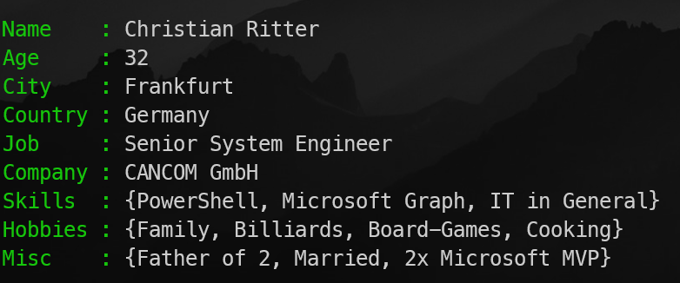
Get-Speaker

Slide 4
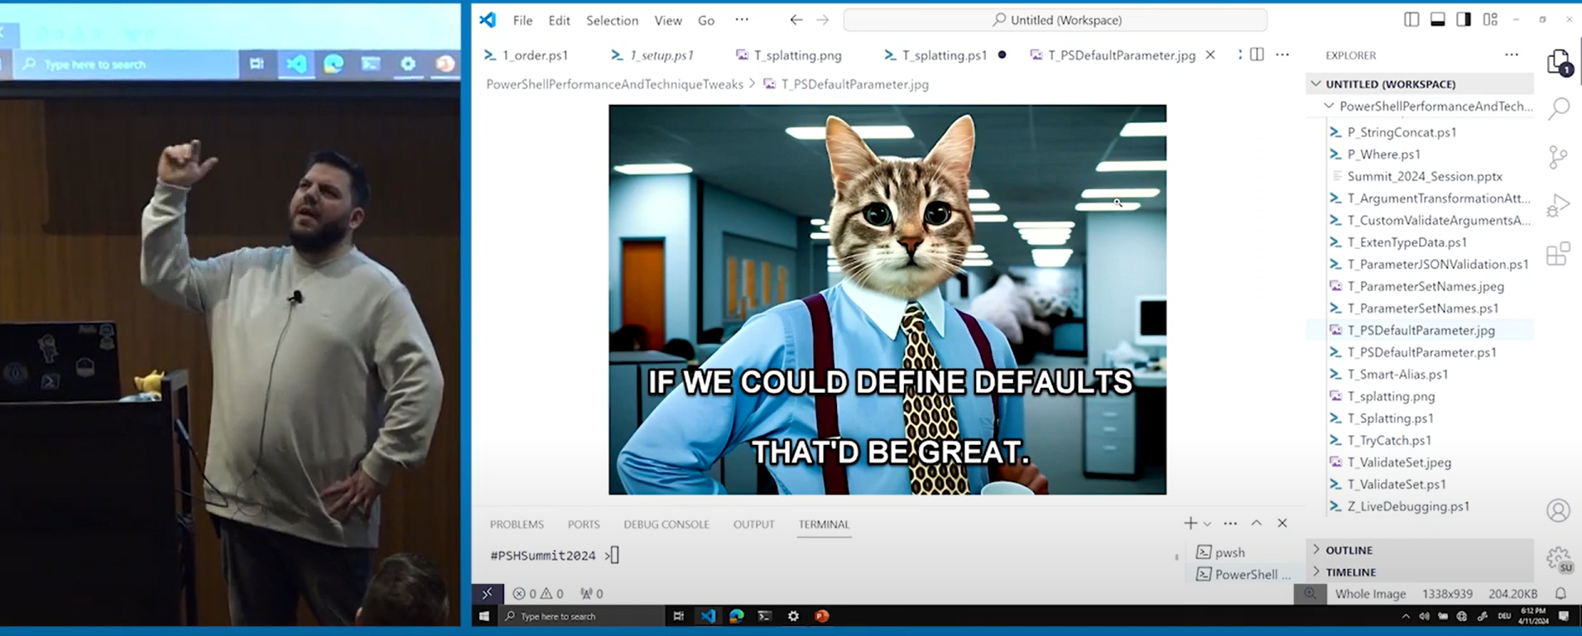
Previously on: Performance and Technique Tweaks: The Full Show

Slide 5

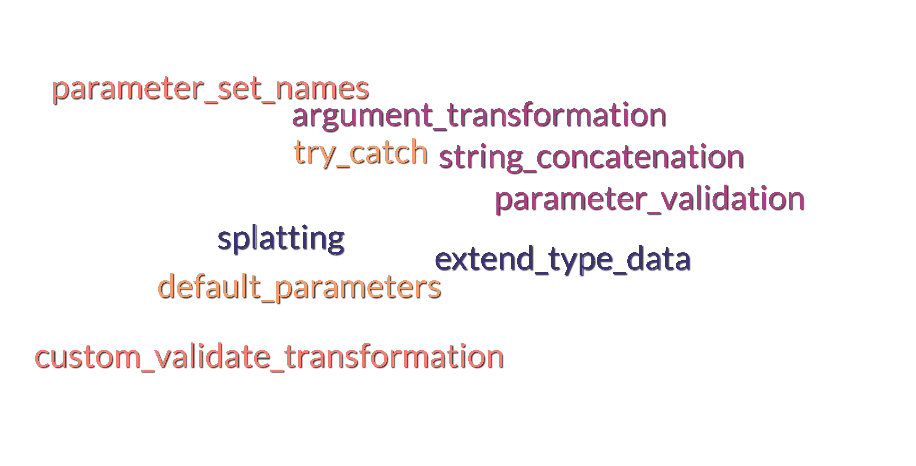

Slide 6
Have any Questions?
Ask them directly!
No worries, I will also have some

Slide 7

Demo-Time

Slide 8

THANK YOU
Feedback is a gift. Please review this session

